Slide 1
Introduction to MRI
27 June 2016

Slide 2
Basis of All MRI – Magnetic Properties of Protons
Protons spin and have angular momentum
This also gives them a magnetic moment
Think of brain as bulk matter with anisotropic distribution of magnetic moments (from H₂0 atoms)
+
N
S
A moving charge creates a current, a current creates a magnetic field (and vice versa)

Slide 3
Why Do We Need a Big Magnet?
Protons spin and have angular momentum
This also gives them a magnetic moment
An externally applied magnetic field will
align the net magnetic moment in it’s own direction.
+
N
B
o
M_{o}
S
A moving charge creates a current, a current creates a magnetic field (and vice versa)

Slide 4
Generating Images – Stuff Happens!
B
o
To generate an image, we excite protons with an RF pulse (magnetic field B₁) orthogonal to B₀
Magnetization protons precesses about B₀ at a frequency proportional to the strength of B₀
This creates a voltage in a receiver coil placed close to the head
Gradients used to alter both frequency and phase of spinning protons, which allows us to localize (i.e., identify where) each of the protons are located => Make pictures!
B
1
Larmor Frequency

Slide 5
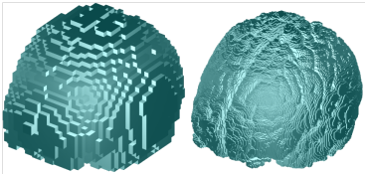
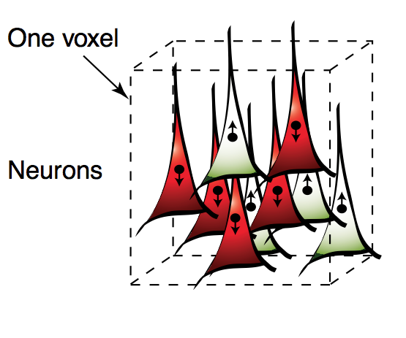
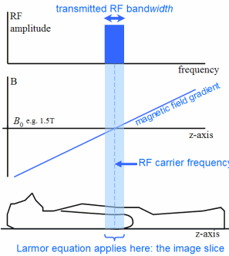
What is a voxel?
In 2D MRI we make a single slice at a time
For axial slices we apply a gradient along z-axis when we turn on the RF pulse
Each slice is broken down into lots of voxels (volume elements) where x, y coordinate corresponds to a unique frequency & phase of relaxation (due to additional gradients)

Slide 6
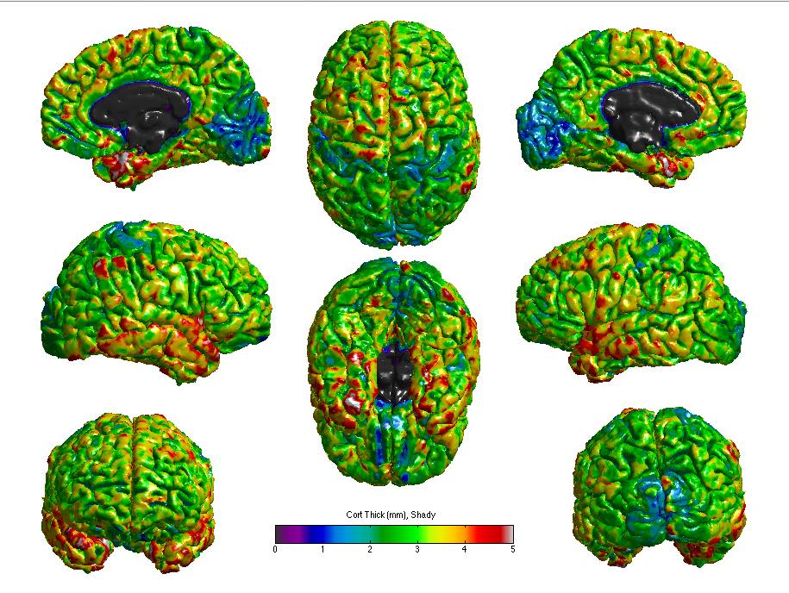
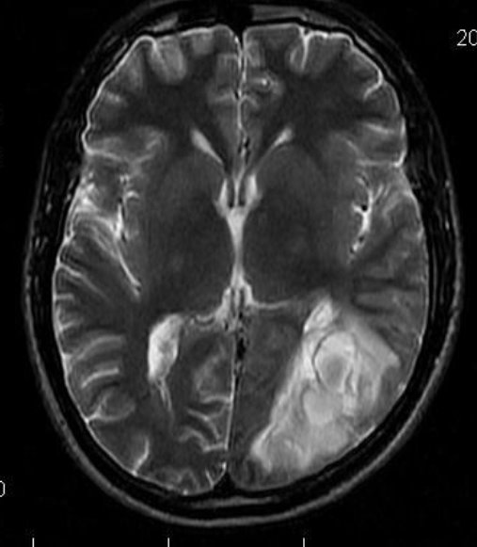
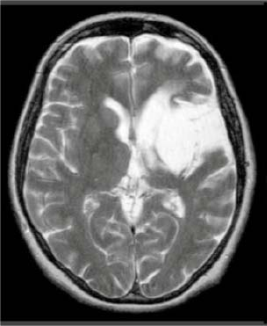
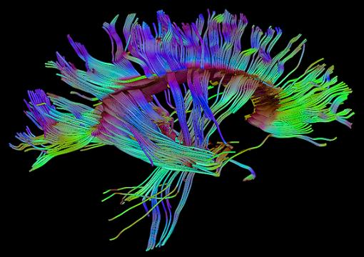
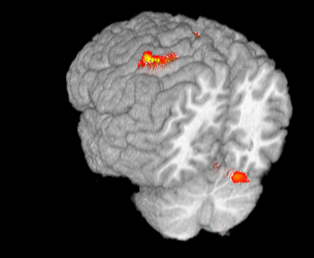
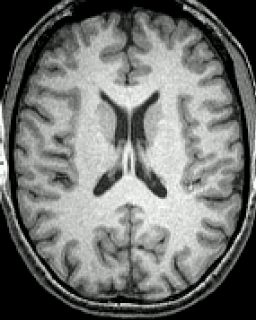
MRI – Powerful Because So Many Contrasts
DTI
T2
PD
BOLD fMRI
Cortical Thickness
T1

Slide 7
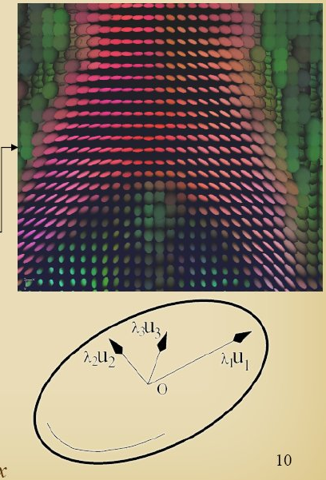
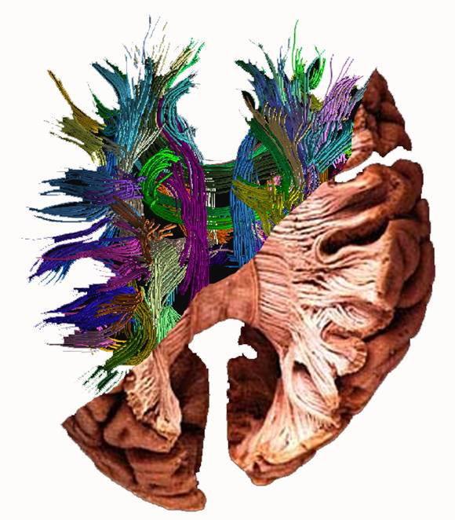
Diffusion Tensor Imaging (DTI)
Measures mobility of water
Water inside an axon is very limited in directions it can move
DTI essentially measures that limited mobility
www.greyc.ensicaen.fr

Slide 8
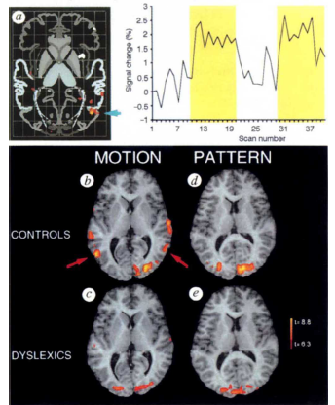
BOLD fMRI
Uses magnetic properties of blood to infer neuronal activity
Thus – it is not a direct measure of neuronal activity
Very useful for non-invasively measuring activity with relatively high spatial resolution and fairly high temporal resolution
Eden, VanMeter et al., 1996

Slide 9
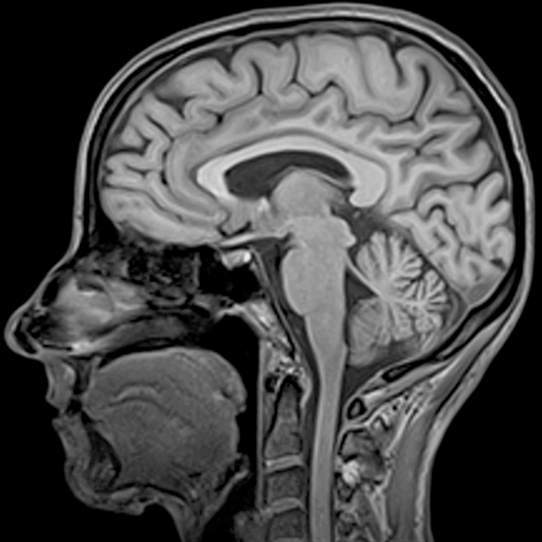
MPRAGE – Main Type of Image Used in FreeSurfer
Magnetization Prepared Rapid Gradient Echo
Provides great contrast between gray and white matter (T1-weighted)
Unfortunately, parts pial surface have about the same intensity as gray matter
This confuses FreeSurfer!!
Notes:
Magnetization Prepared Rapid Gradient Echo pulse sequence

Slide 10
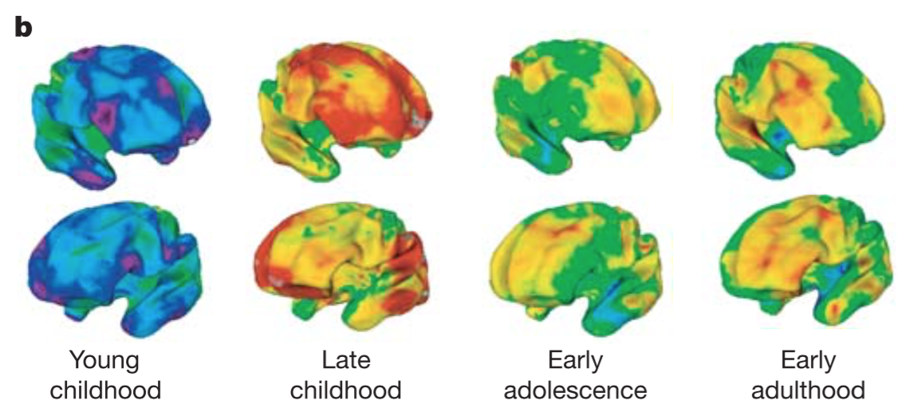
Cortical Thickness – Changes with Age
Shaw et al. 2006

Slide 11
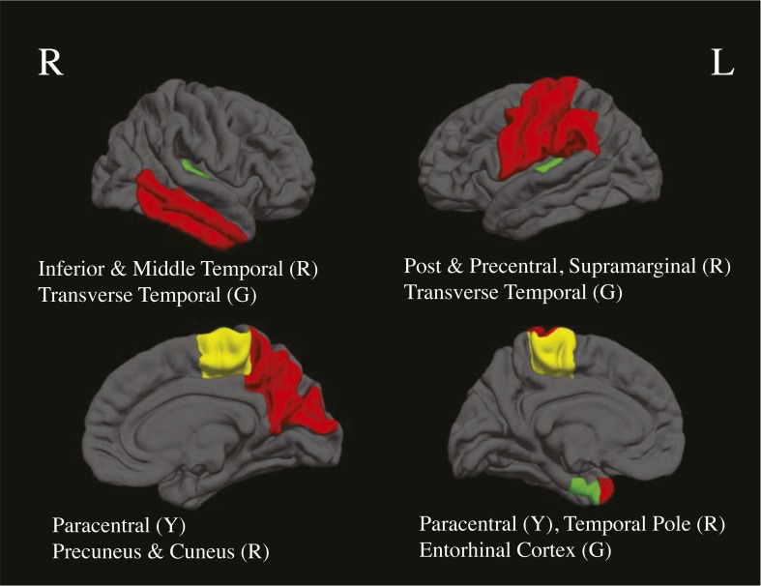
Cortical Thickness in MJ & Alcohol Users
MJ, Alcohol compared to non-users
Mean age 17.4 yo
Reduced thickness in Alcohol users (red)
Reduced thickness in MJ users (green)
Reduced in both users (yellow)
Jacobus et al. 2014

